Slide 1

Project 3 - Visualizing Data
The GAP Team: Shailesh, Marc, Ellis

Slide 2

Project Overview: Food Desert

Slide 3

We will identify locations that have very few grocery stores serving a large population (also
known as Food Desert) and determine the factors that contribute toward the situation.

Slide 4


Why do we choose this topic?
HEALTHY FOOD SCARCITY
POPULATION
Does low income population lead to a food desert?
Does the number of fast food places correlate with population?

Slide 5

Our Approach
Our study will consist of counties in the state of Georgia

Slide 6
Our Process
01
DATA SOURCES
04
DATABASE
census.gov
gadoe.org
foursquare.com
google API
Plan & construct schema using Prostgre SQL
02
PROGRAMMING
05
VISUALIZATIONS
Python
Plotly
Dash
JavaScript
bar-line combination chart
stacked bar chart
scatter plot
03
DATA MUNGING
06
WEB DEVELOPMENT
combine
sort
clean (remove dups, drop columns)
<Briefly elaborate on what
you want to discuss.>

Slide 7

Our Database Relationship Diagram

Slide 8
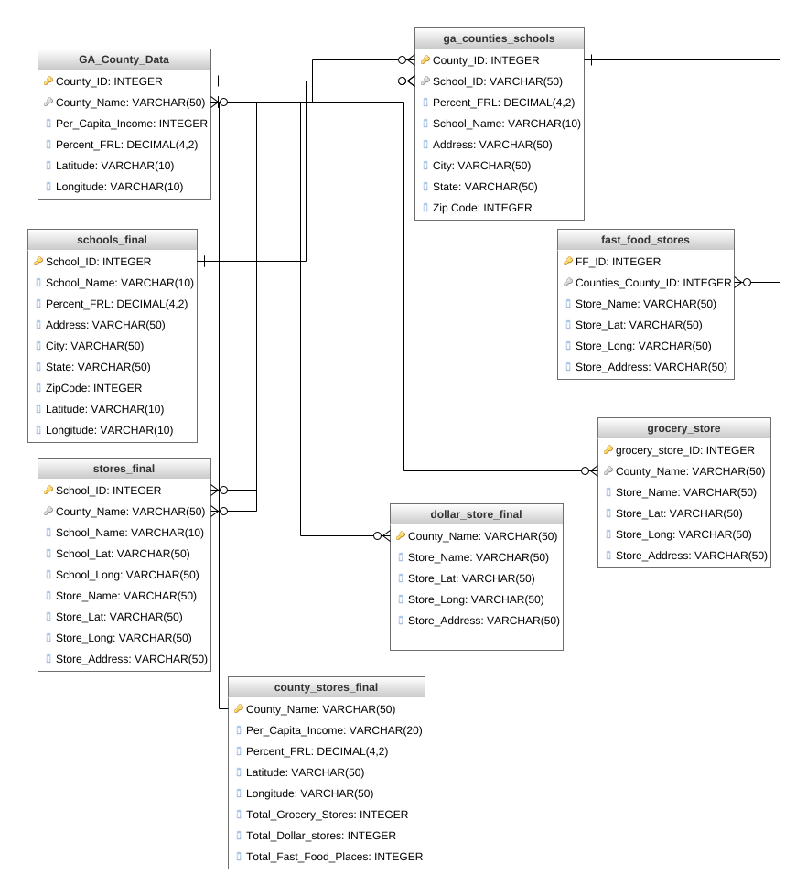
Access the full diagram:
app.genmymodel.com

Slide 9

Data Visualizations
Four charts will be presented in the following slides

Slide 10
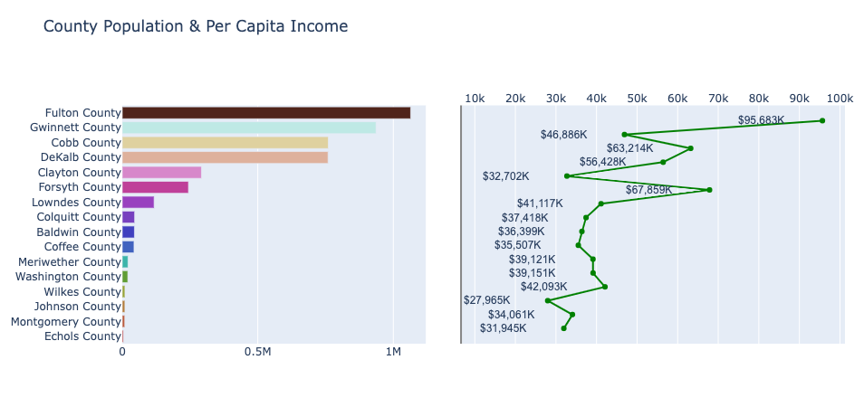
Chart #1
These 2 graphs show the correlation between County Population and Per Capita Income. Counties with a high population tend to have a higher Per Capita Income than those with a lower population.

Slide 11
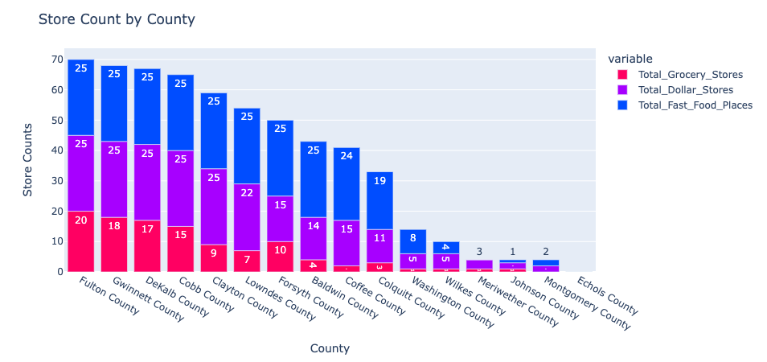
The graph shows that there is a moderate pattern of equal distribution of Fast Food, Dollar and Grocery Stores. There are many confounding variables that may influence this behavior pattern, but one variable may be due to the population of each county. A higher population may lead to more stores than a lower population.
Chart #2

Slide 12
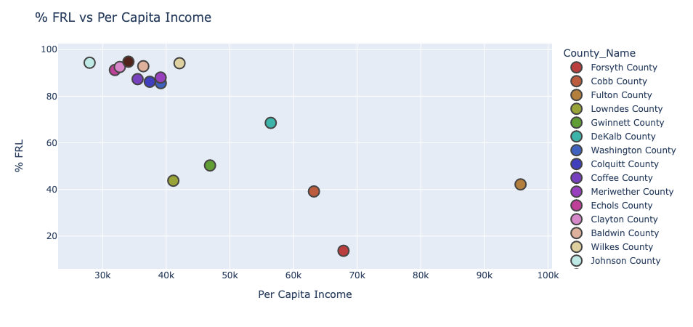
The graph shows that there is a weak negative correlation between a county's % FRL and it's Per Capita Income. There is a cluster of counties located where the % FRL is high and the Per Capita Income level is low. The high % FRL may be due to the low Per Capita Income level of that county. As the Per Capita Income level of a county increases, the % FRL decreases. The low % FRL may be due to the high Per Capita Income level of that county.
Chart #3

Slide 13
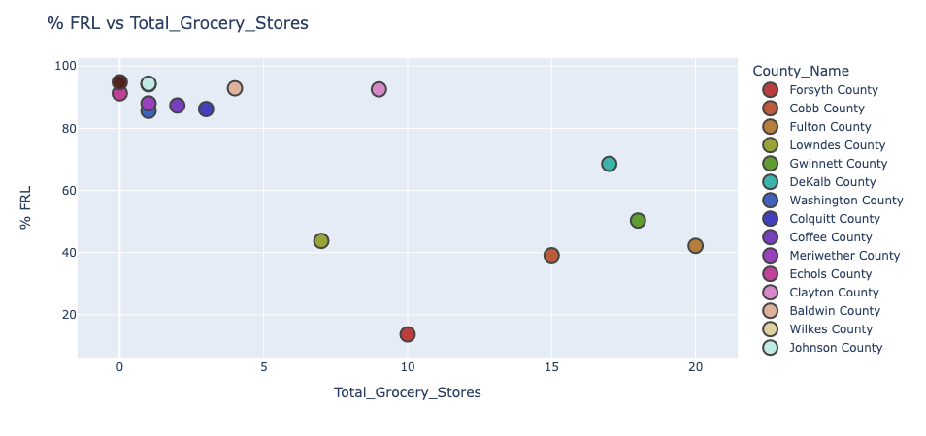
Like Chart #3, this graph shows a weak negative correlation between a county's % FRL and it's Total Grocery Stores. There is a cluster of counties located where the % FRL is high and the Grocery Store count is low. The high % FRL may be due to the low Per Capita Income level of that county. As the Grocery Stores count of a county increases, the % FRL tend to decrease.
Chart #4

Slide 14

Web Development Demonstration

Slide 15
Conclusion
Areas with higher levels of poverty are more likely to be food deserts

Slide 16

Thank You!
Are there any questions?

